Slide 1
.NET 5: The Journey to One .NET Becomes Reality
Dave Brock (@daveabrock) MADdotNET – November 4, 2020

Slide 2





About Me
I am a:
Software engineer – By day, I work on building out Azure solutions for development teams. I also work on open source when time permits
Writer – I write a lot on the side about .NET and programming:
daveabrock.com – I write posts once a week about Blazor, ASP.NET Core, C#, and Azure
The .NET Stacks – A weekly newsletter where I discuss trends, interview leaders, and provide weekly links
Dad – Two “child components” aged 6 and 3
@daveabrock daveabrock.com
@dotnetstacks dotnetstacks.com

Slide 3
C# 9: Functionally Better
C# 9 ships with .NET 5 and Visual Studio 16.8!
Records – define class types which act as values (types traditionally encapsulate state via methods and properties, values are the opposite, json values are value style objects, need equality, deconstructions, and immutability)
C# 8 – nullability – more work, catching up on some stuff
– By day, I work on building out Azure solutions for development teams, and also work on open source when time permits
@daveabrock daveabrock.com
@dotnetstacks dotnetstacks.com

Slide 4

C# 9: Functionally Better?
From Isaac Abraham, who runs an F# consultancy (Compositional IT):
“On the one hand, for the C# dev it’s great—they have a more powerful toolkit at their disposal. But I would hate to be a new developer starting in C# for the first time. There are so many ways to do things now.
More than that, I worry that we’ll end up with a kind of bifurcated C# ecosystem—those that adopt the new features and those that won’t … and the risk of losing the identity of what C# really is.
I’m interested to see how it works out. Introducing things like records … is going to lead to some new and different design patterns being used that will have to naturally evolve over time.”
@daveabrock daveabrock.com
@dotnetstacks dotnetstacks.com

Slide 5

C# 9: Functionally Better?
From Phillip Carter, an F# PM at Microsoft:
“You can do immutable programming in C# today, and C# records will help with that. But it’s still a bit of a chore because the rest of the language is just begging you to mutate some variables.
C# is evolving into a more unopinionated language that lets you do just about anything in any way you like…this lack of emphasis on one paradigm over the other can lead to vastly different codebases despite being written in the same language.
Is that okay? I can’t tell. But I think it makes identifying the answer to the question, “how should I do this?” more challenging.”
@daveabrock daveabrock.com
@dotnetstacks dotnetstacks.com

Slide 6
C# 9: Top-Level Programs
Top-level programs allow you to write code:
Which return anything
Without a traditional main method
With support for “magic parameters”
And allows local functions!
@daveabrock daveabrock.com
@dotnetstacks dotnetstacks.com

Slide 7
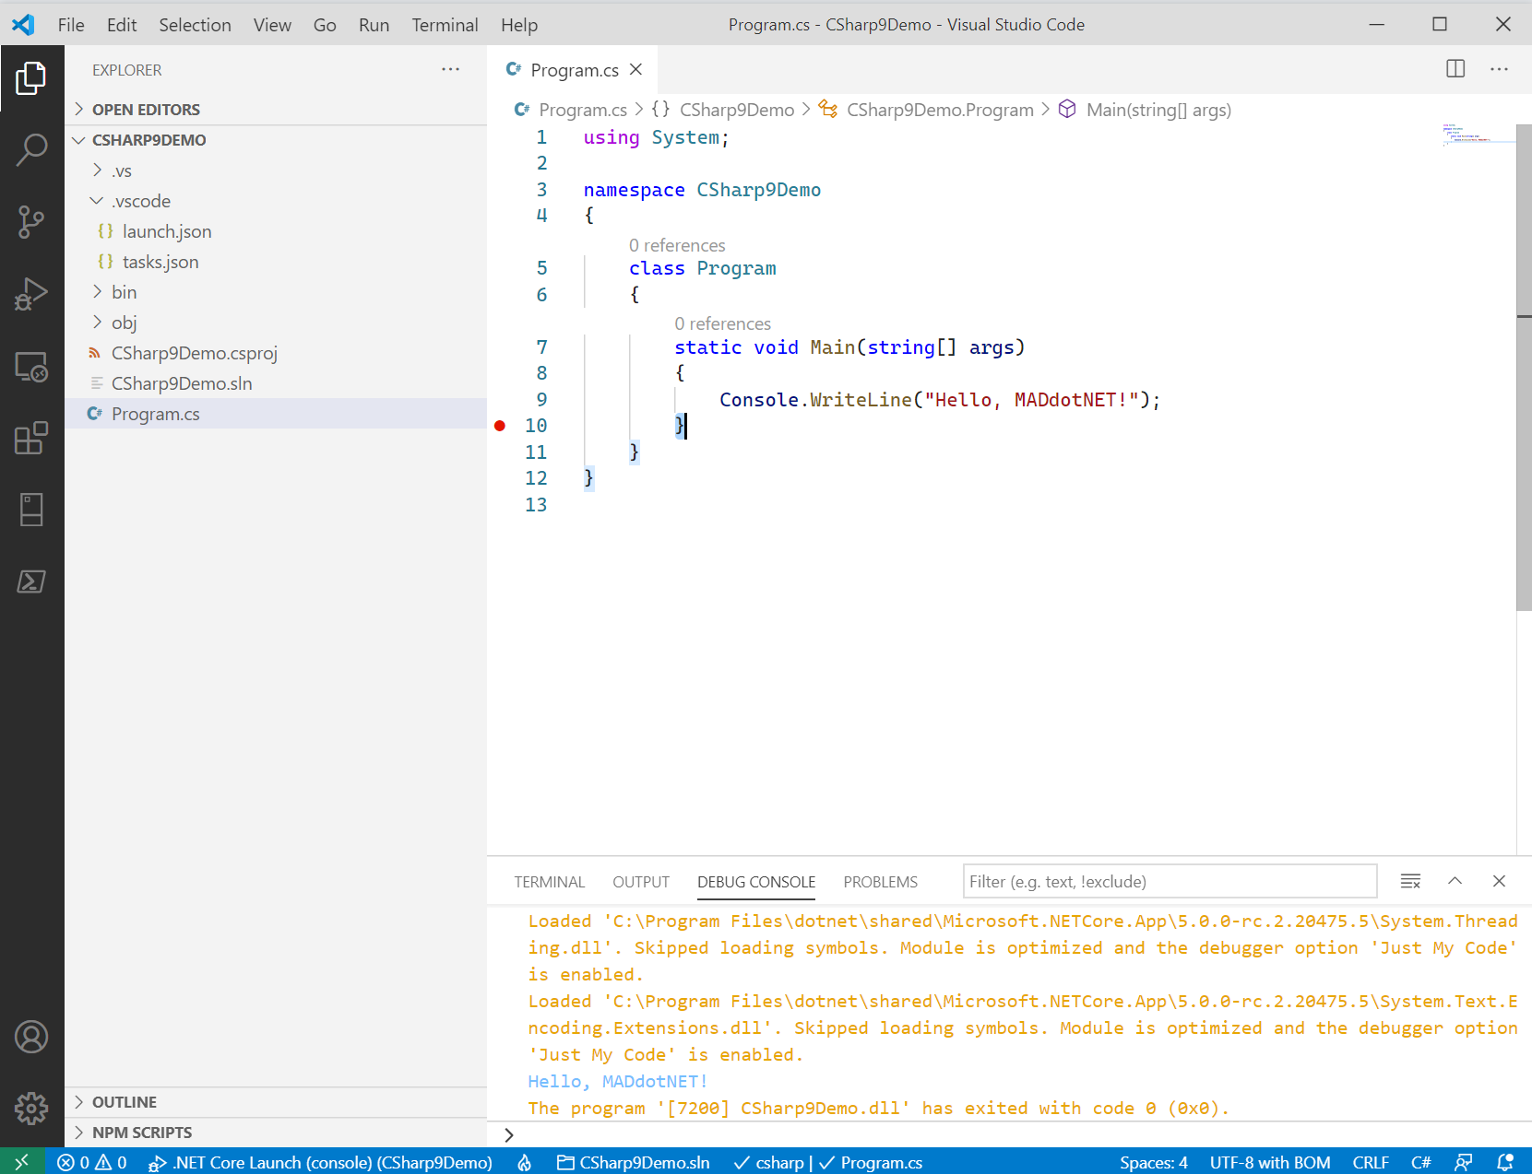
Notes:
This is a traditional console app.

Slide 8
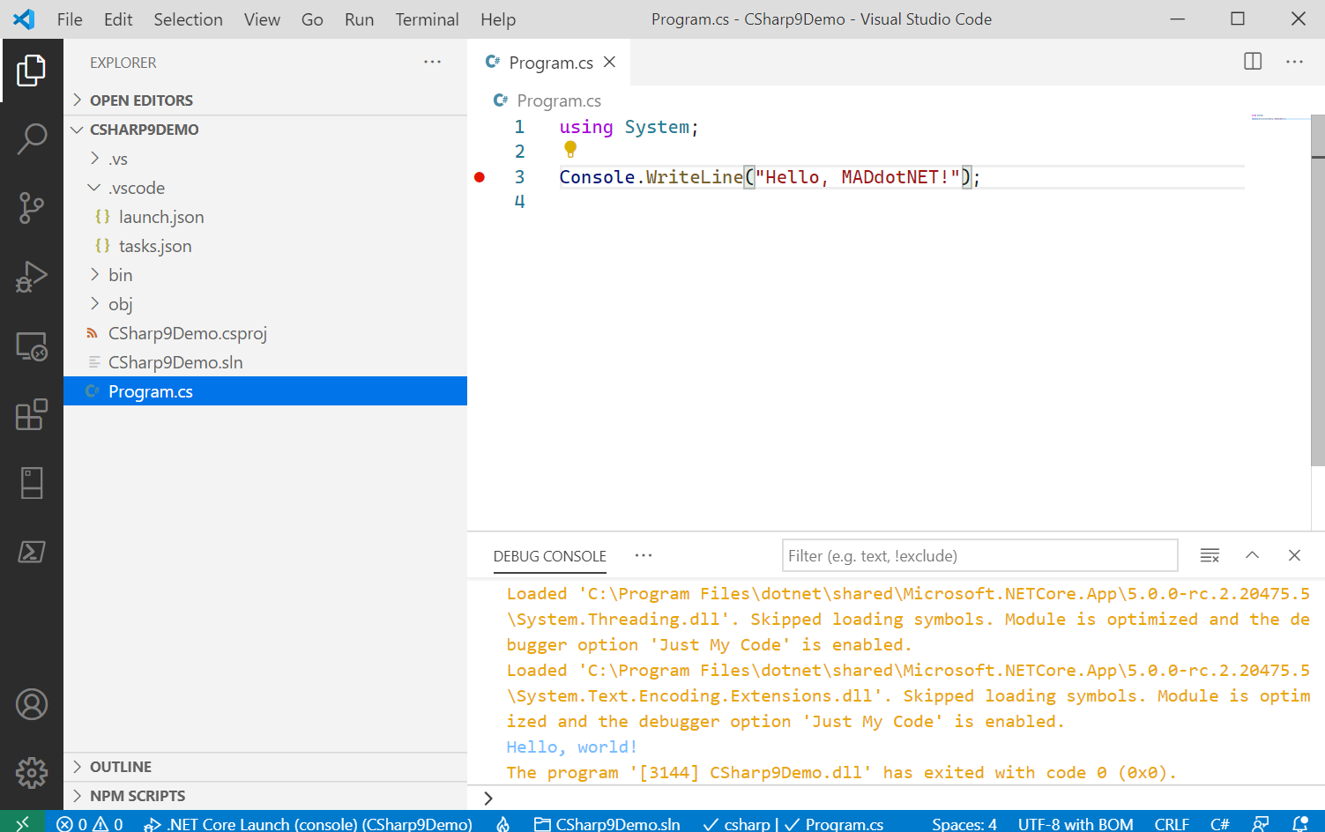
Notes:
Here’s a top-level statement with a using.

Slide 9
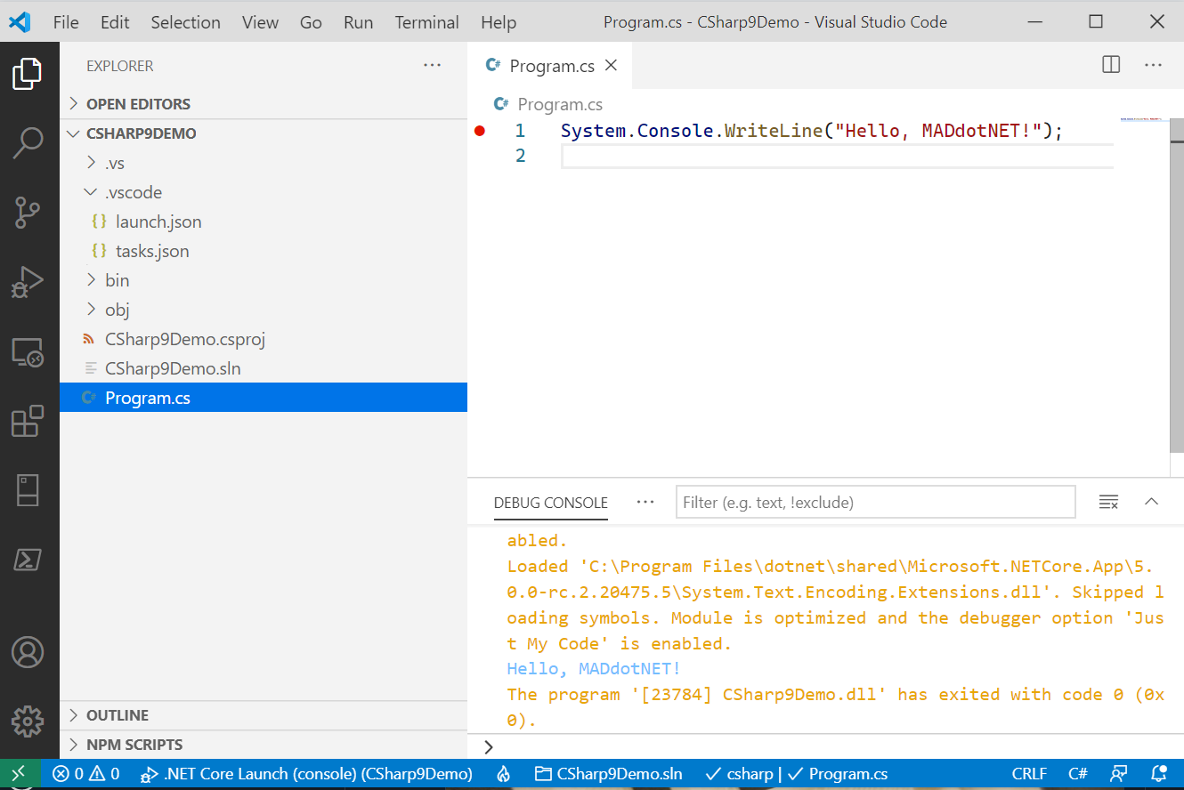
Notes:
Here’s a top-level statement without a using.

Slide 10
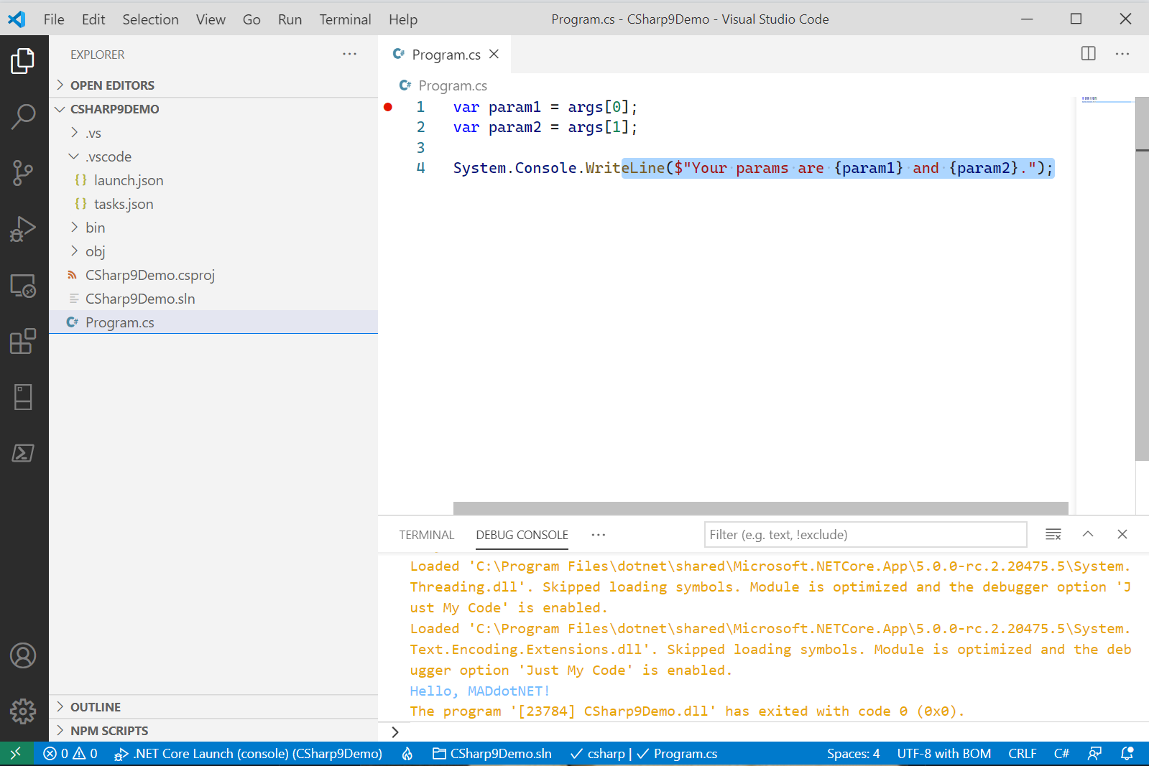
Notes:
Top-level statements also take in *magic* parameters.

Slide 11
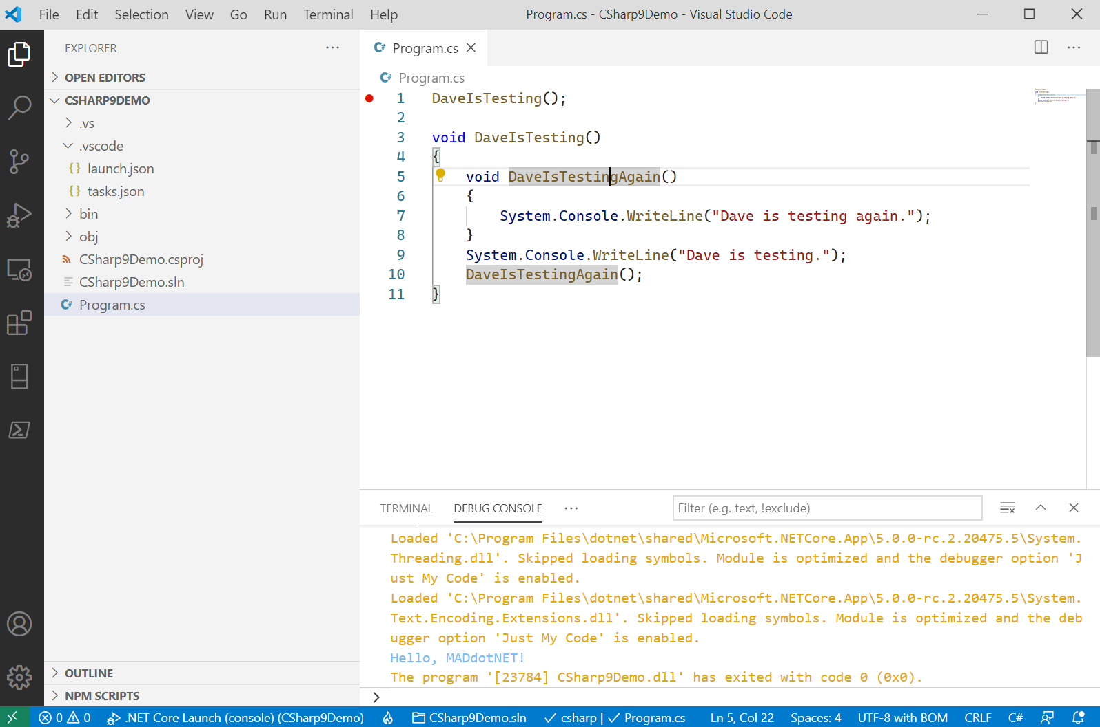
Notes:
Top-level statements also support local functions.

Slide 12
C# 9: Init-only properties
Init-only properties:
Allow you to have properties that resemble immutability
The init keyword prevents you from mutating an object after initialization/instantiation
@daveabrock daveabrock.com
@dotnetstacks dotnetstacks.com

Slide 13
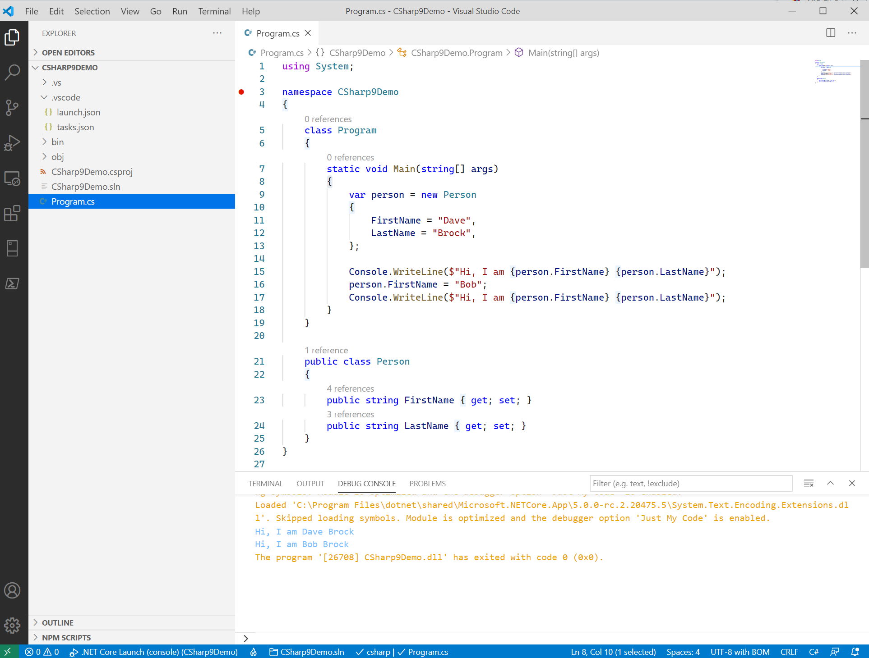
Notes:
Here’s how you’d typically mutate an object.

Slide 14
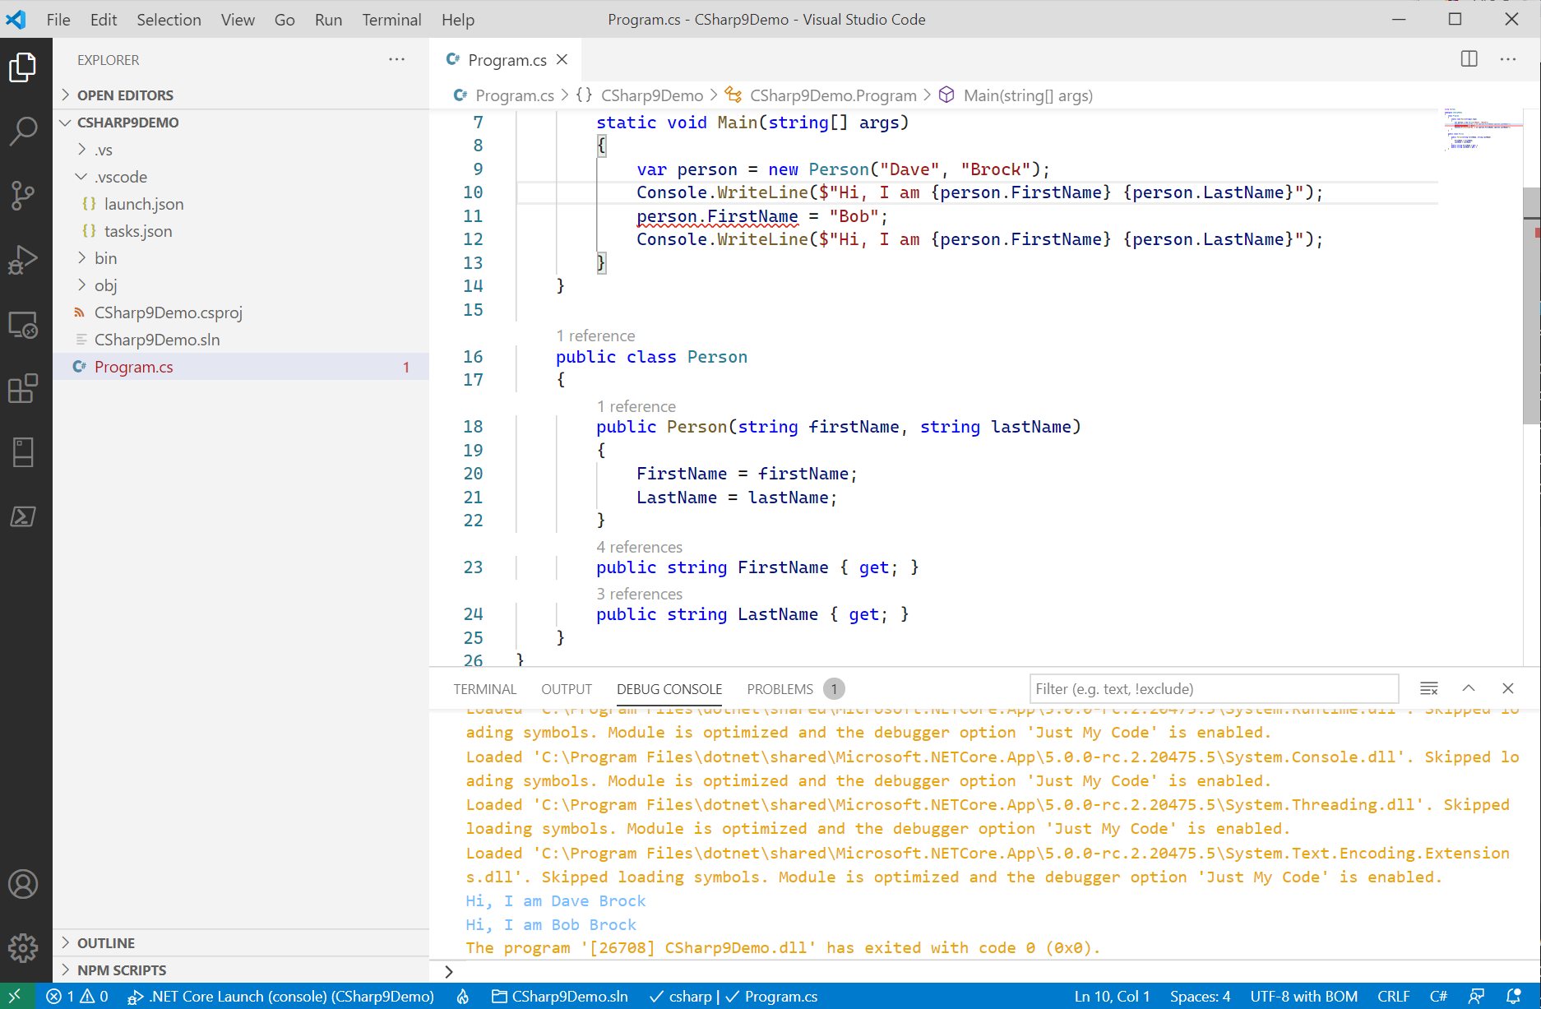
Notes:
You can typically mimic this in C# 8 using readonly properties.

Slide 15
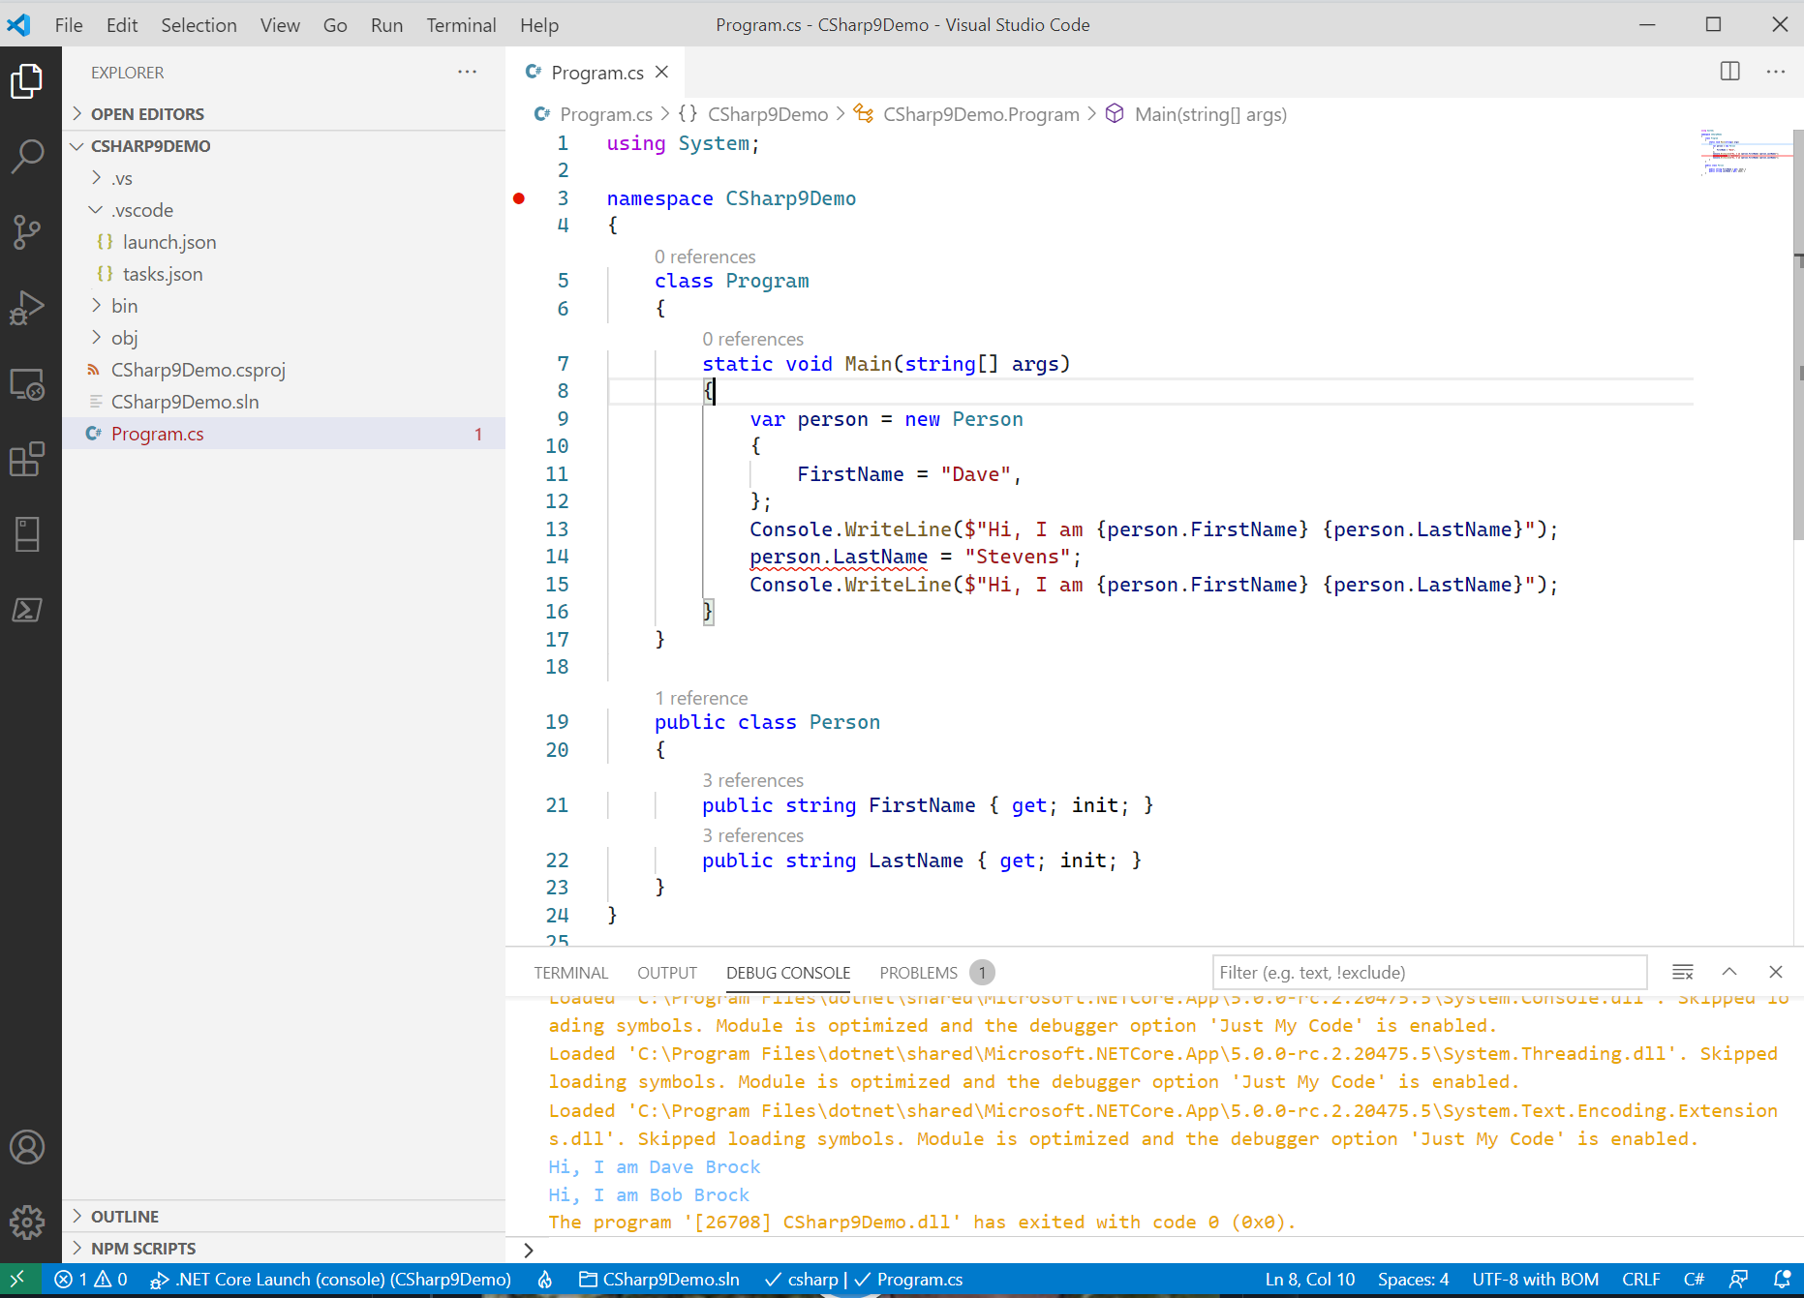
Notes:
Init properties are optional, but it doesn’t mean you can set after instantiation

Slide 16
C# 9: Records
Records are the core feature in C# 9
Records allow you:
To work with immutable types
To perform data-like behaviors on properties
Are struct-like, but:
Provide an easy construct with the purpose of providing immutability
Provides support for IEquatable<T> interface without having to override them (but you can)
Constructor/deconstructor support
@daveabrock daveabrock.com
@dotnetstacks dotnetstacks.com

Slide 17
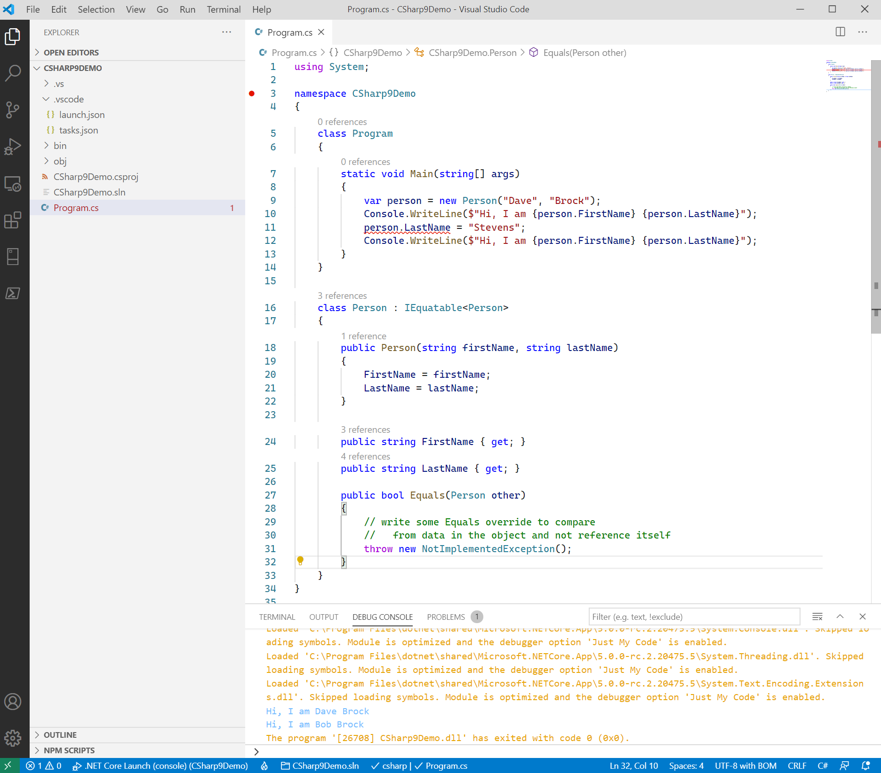
Notes:
Here’s how you would do it with positional records.

Slide 18
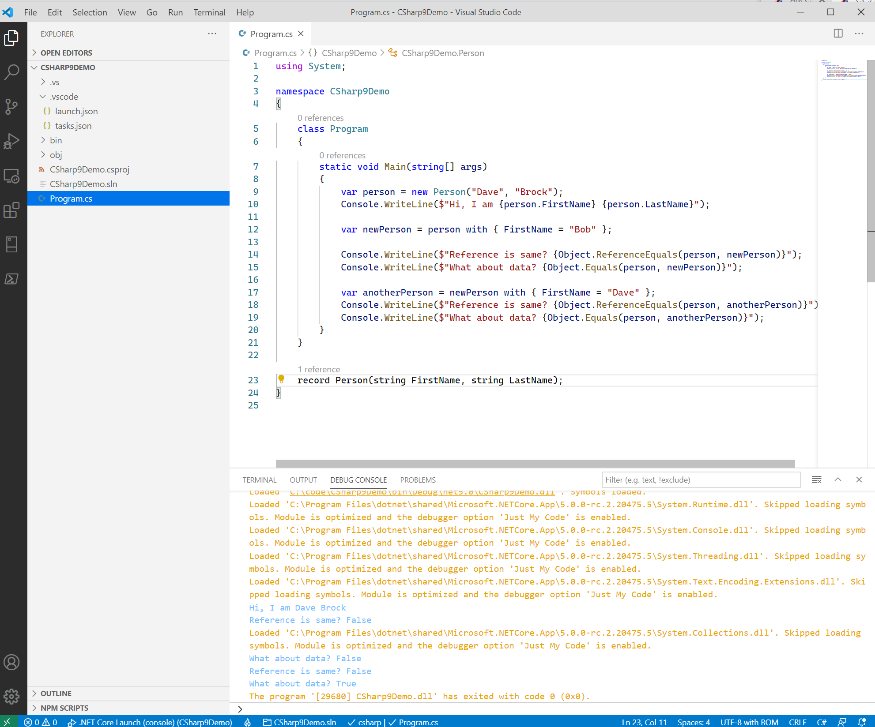
Notes:
Here’s how equality works with “with operators”

Slide 19
C# 9: Records
Are they immutable by default? Are they not?
YES.
Positional records are immutable by default
Relational records require the use of init properties coupled with object initializers
@daveabrock daveabrock.com
@dotnetstacks dotnetstacks.com

Slide 20
C# 9: Target Typing
Target typing:
Allows C# to get type from its context on the right side of the equals operator
As a result, you can’t pair it with the var keyword or ternary statements
Works great with collections
@daveabrock daveabrock.com
@dotnetstacks dotnetstacks.com

Slide 21
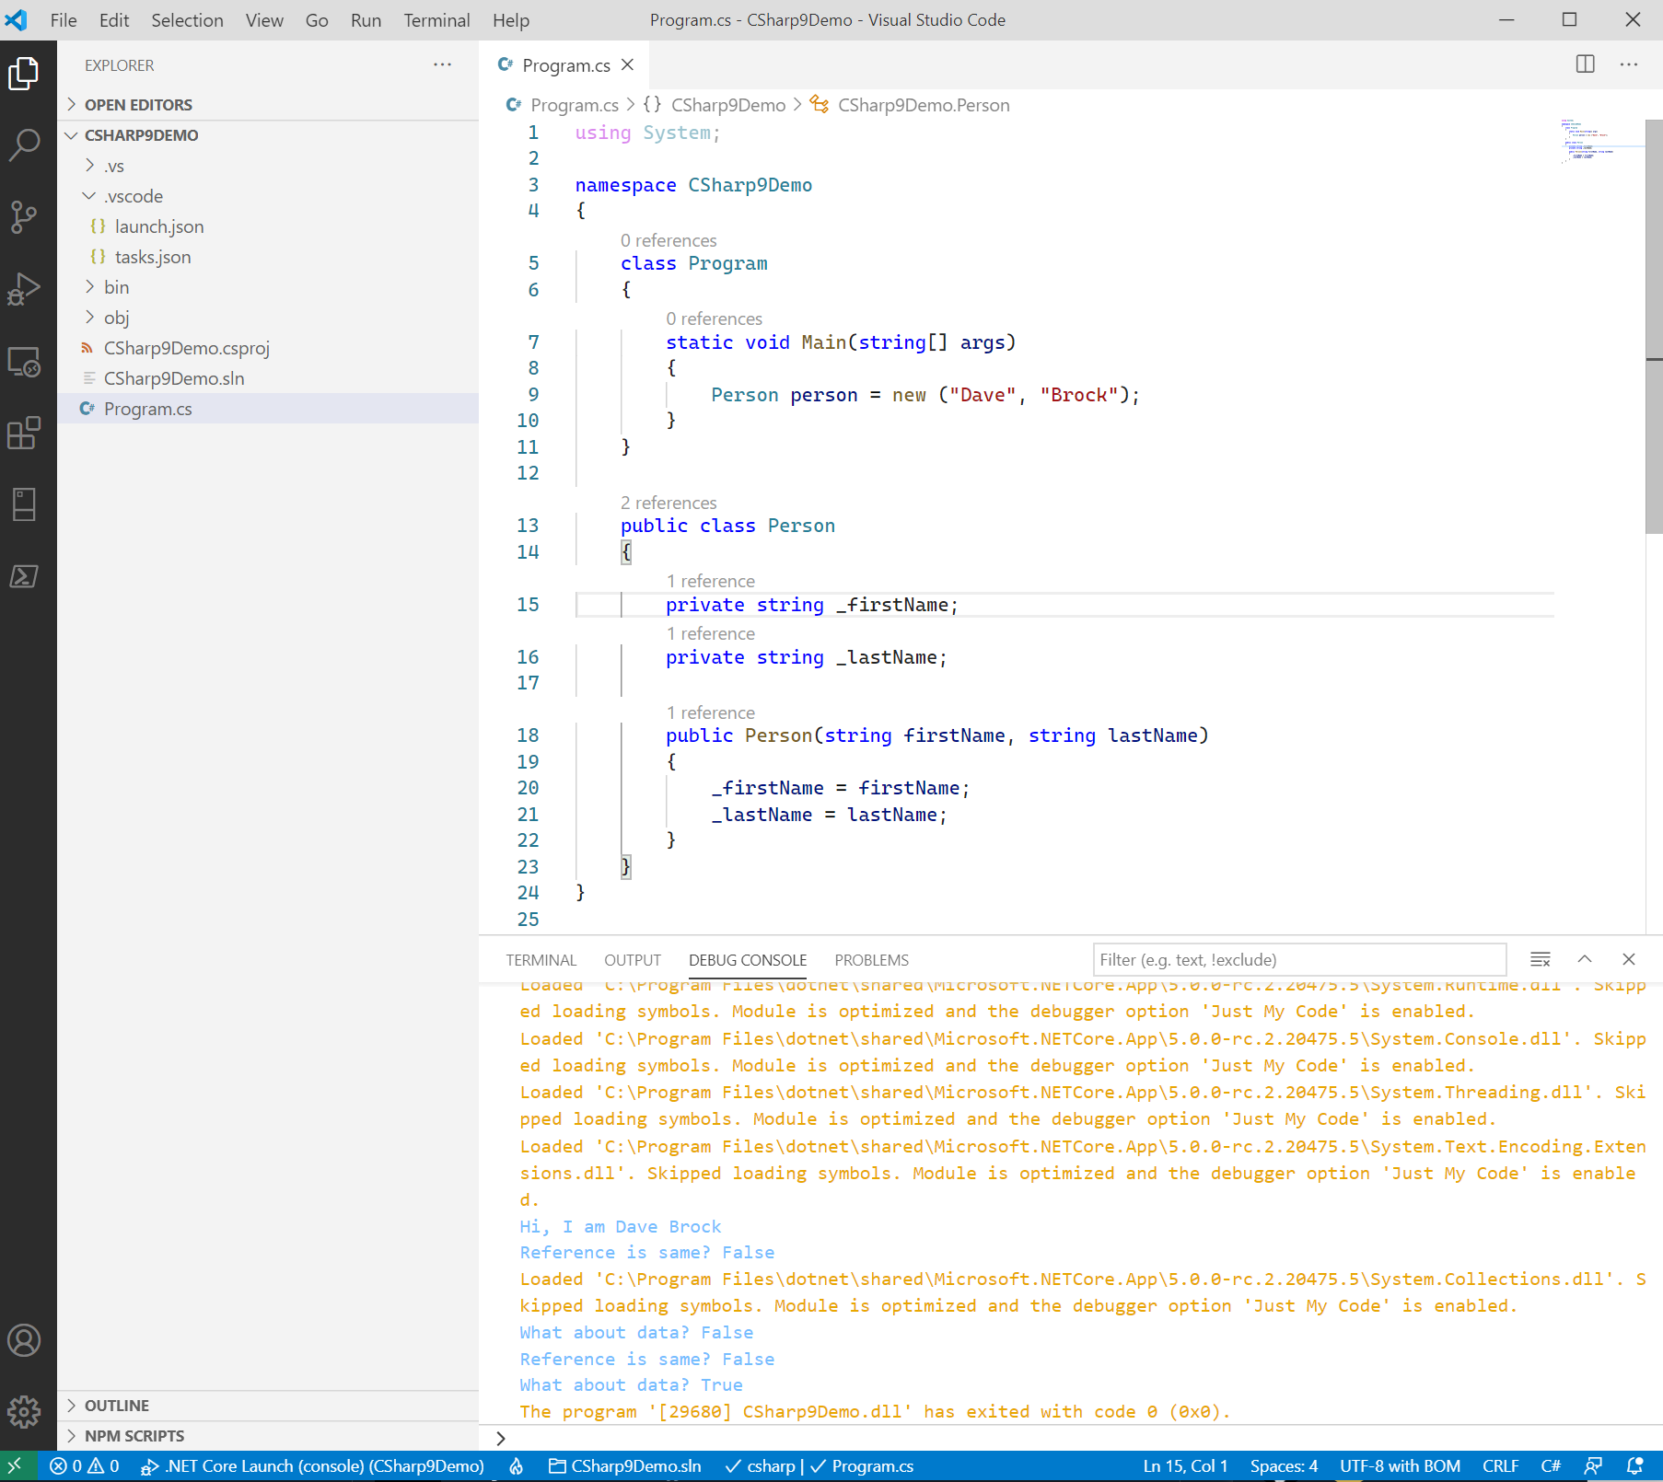
Notes:
Here’s how equality works with “with operators”

Slide 22
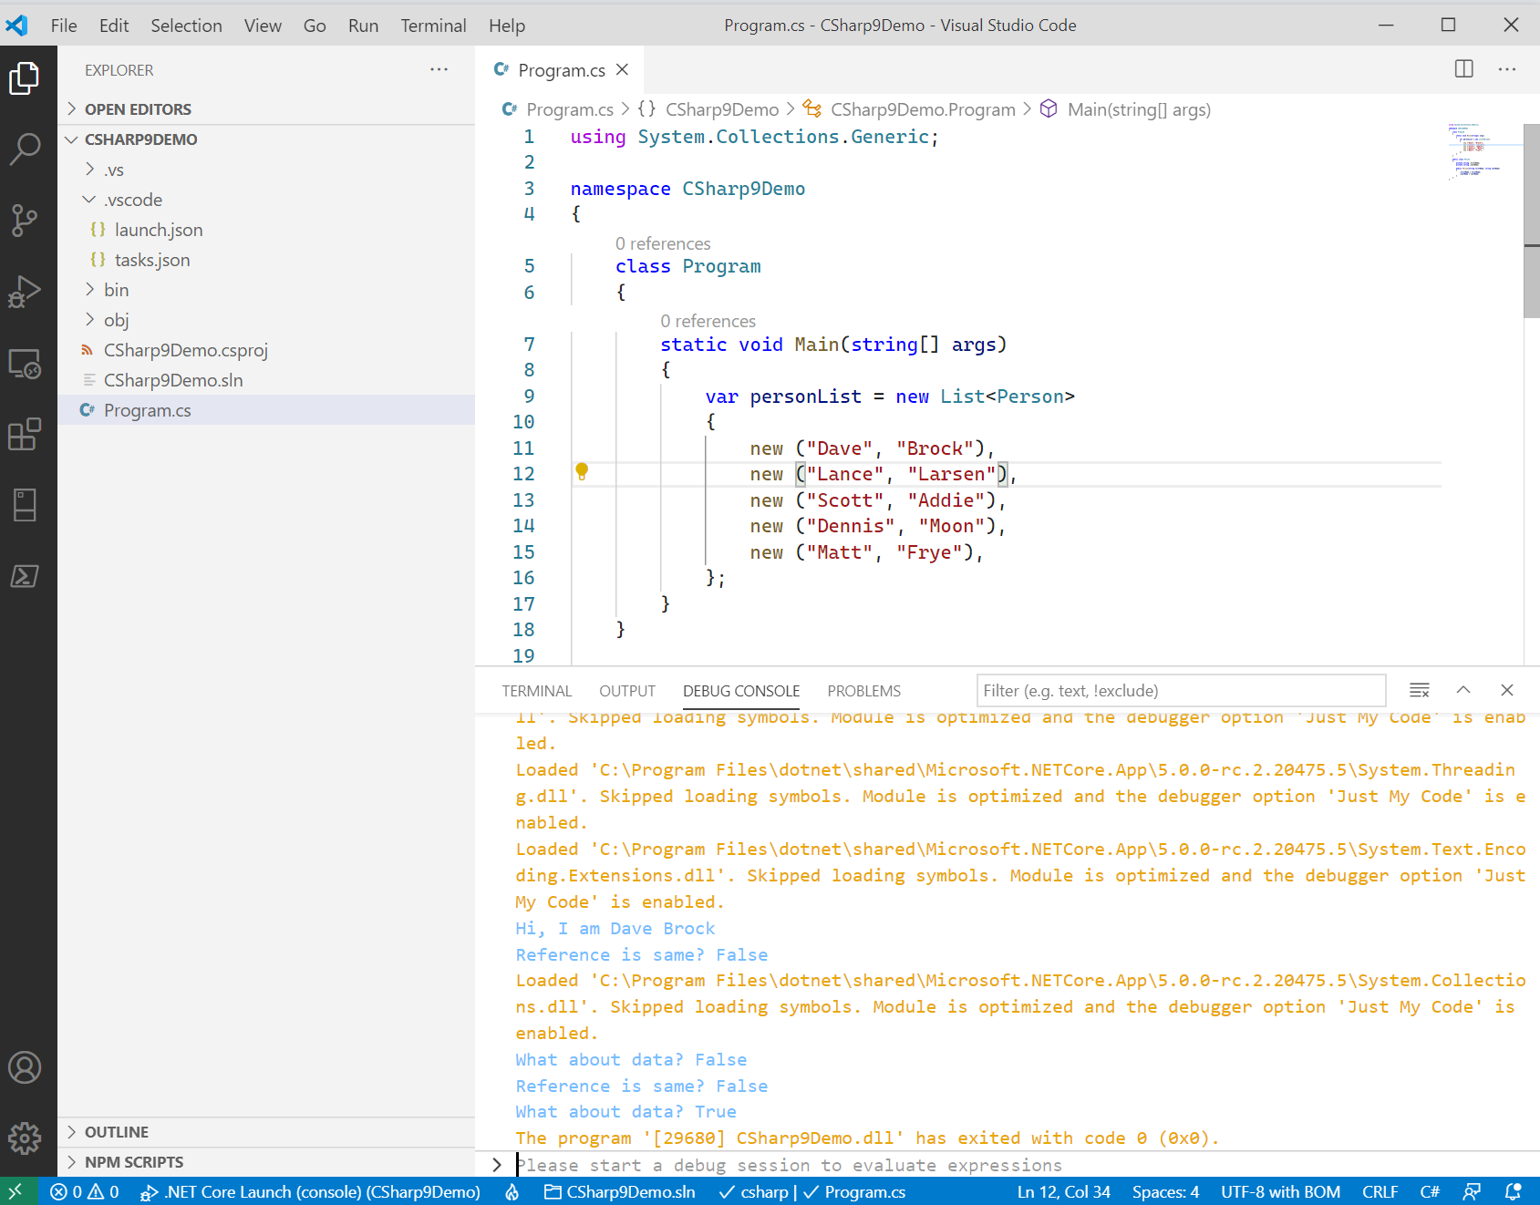
Notes:
Here’s how it works with collections

Slide 23
C# 9: Learn More
We’re just scratching the surface! Check out the docs to also learn about…
Pattern matching
Covariant return types
Lambda discards
Local function attributes
Module initializers
Native sized integers
… and much more
@daveabrock daveabrock.com
@dotnetstacks dotnetstacks.com

